Slide 1
Engineering
Portfolio
By Kasman Andries Sitio

Slide 2
Table Of Contents
01 Prototype-Ethanol Car
02 Urban-Ethanol Car
03 Payload Rocket (Electric Ducted Fan)
04 Re-designed cocoa production process
05 Semi Muhle Mill (Cocoa Grinder)
06 Tank Collecting
07 Cocoa Butter Filtration Machine

Slide 3
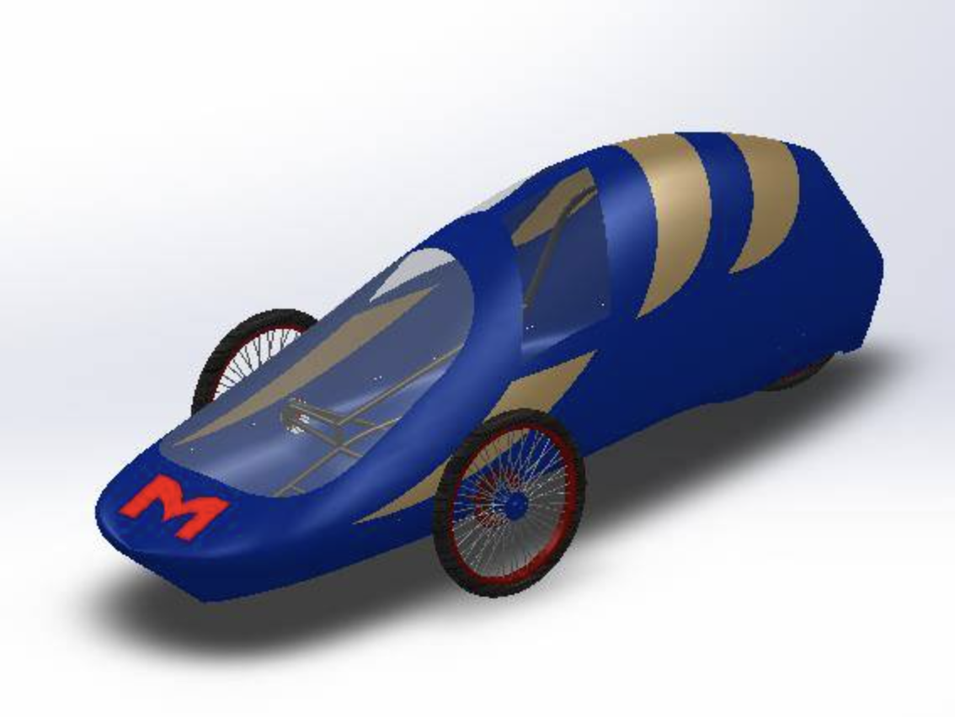
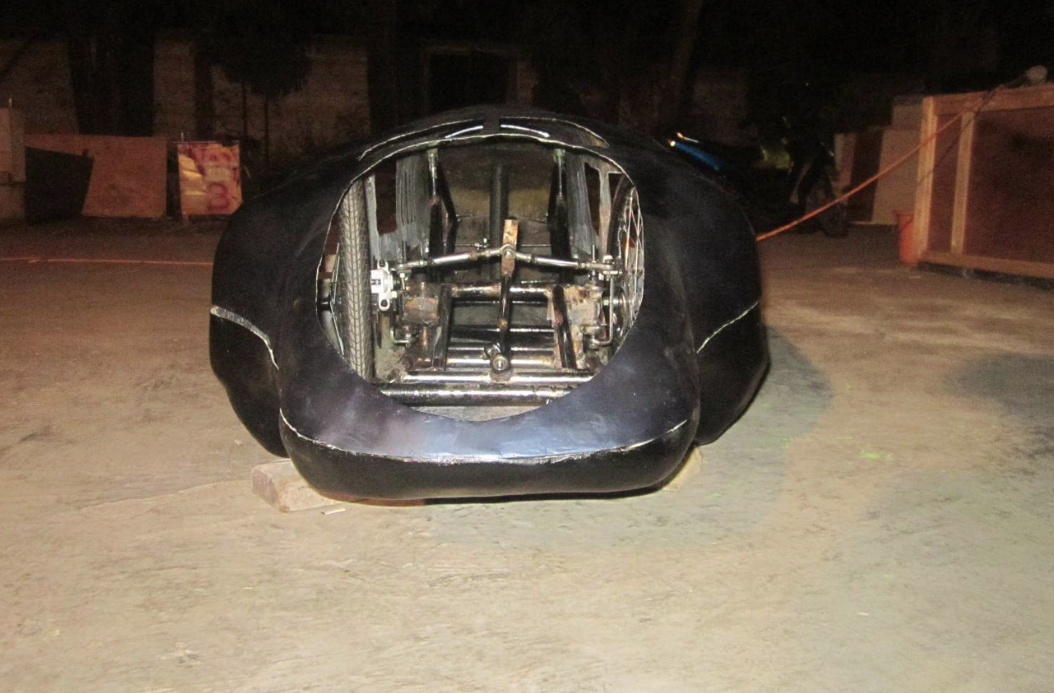
Prototype-Ethanol Car
01
The design of the energy-efficient car unveiled at KMHE (Kompetisi Mobil Hemat Energi) 2016, located in UGM, Yogyakarta. The car body is made of polycarbonate and the chassis frame is made of aluminum.
The race in the prototype category focuses on cars that can cover the longest distance with the most aerodynamic and lightest design possible.

Slide 4
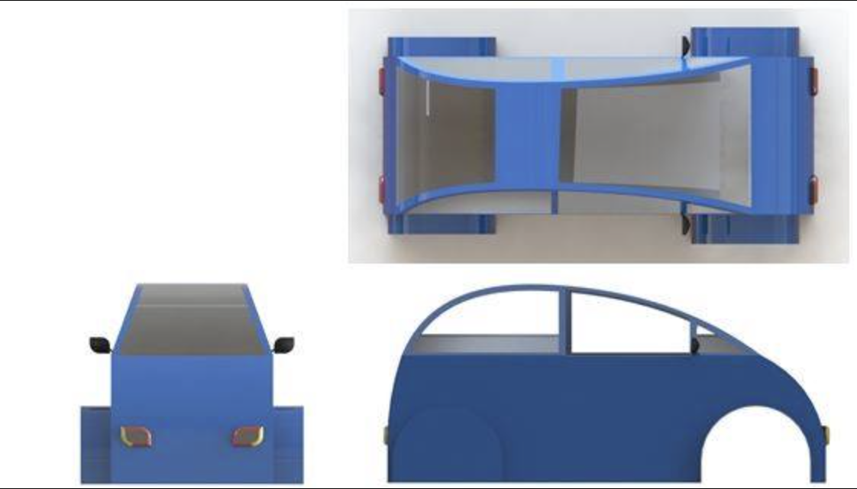
Urban-Ethanol Car
02
The urban category features the concept of the energy-efficient car of the future. Shaped like a city-car, urban-type cars are still designed to meet energy-saving demands.

Slide 5

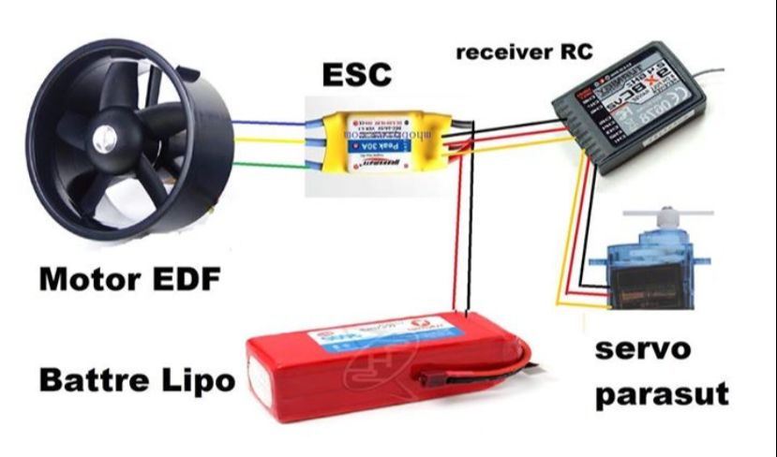
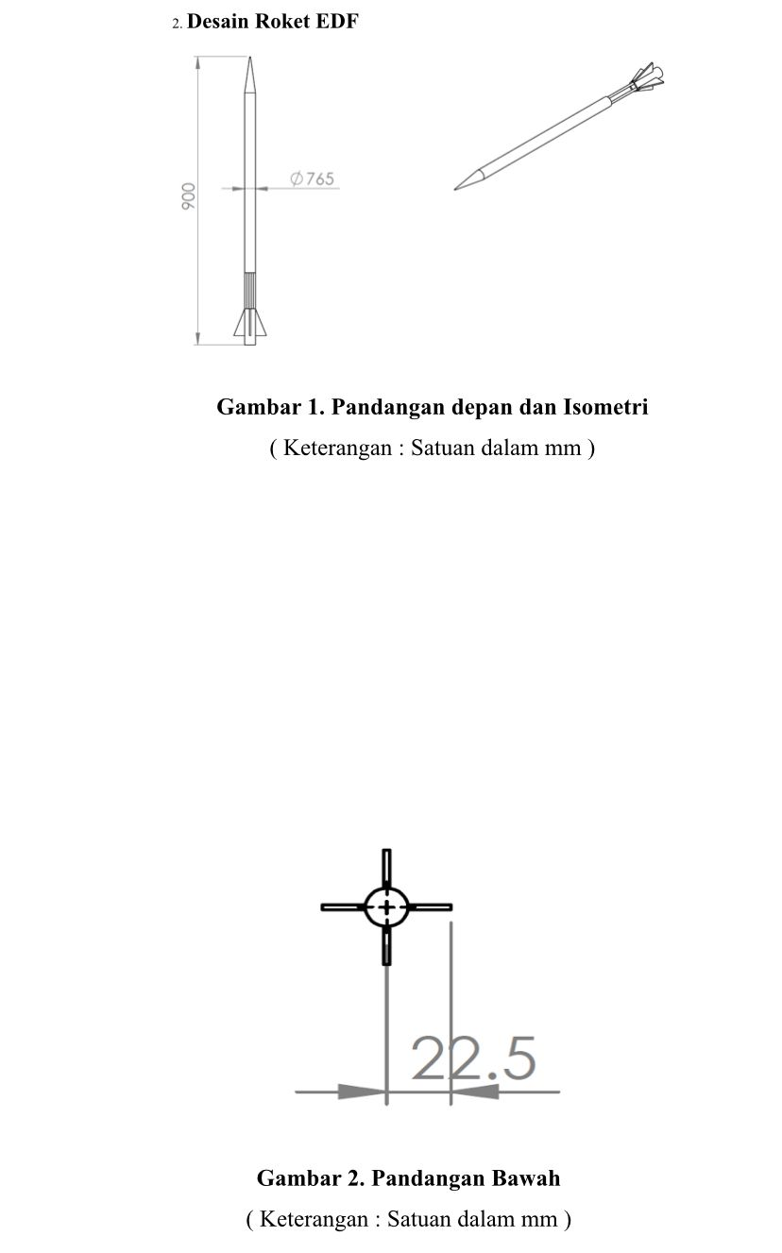
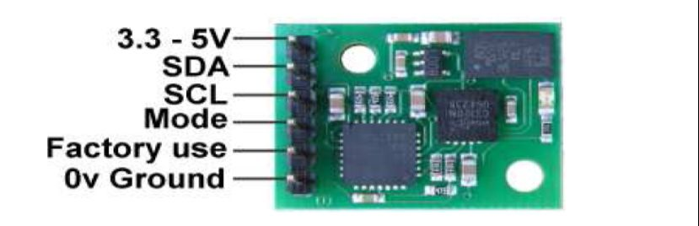
Payload Rocket (Electric Ducted Fan)
03
In KOMURINDO (Kompetisi Muatan Roket Indonesia) 2015 Payload Rocket category, our team asked to design a payload or rocket payload that is used to monitor the position and attitude of the rocket. The results of this rocket monitoring are then displayed through a GUI (Graphical User Interface) that has been created by the participants. In addition, the payload must also be able to take pictures from the air and send them to the GUI that has been created.

Slide 6
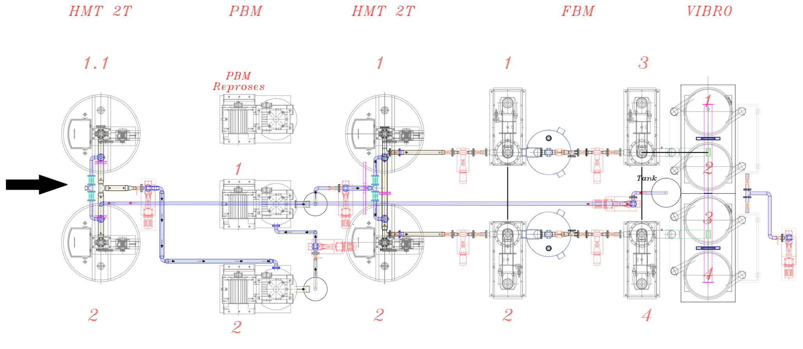
Re-designed cocoa production process
(Mechanical and Piping, product transfer)
04
Replaced mechanical and piping design to maximize product transfer power according to machine capacity.

Slide 7
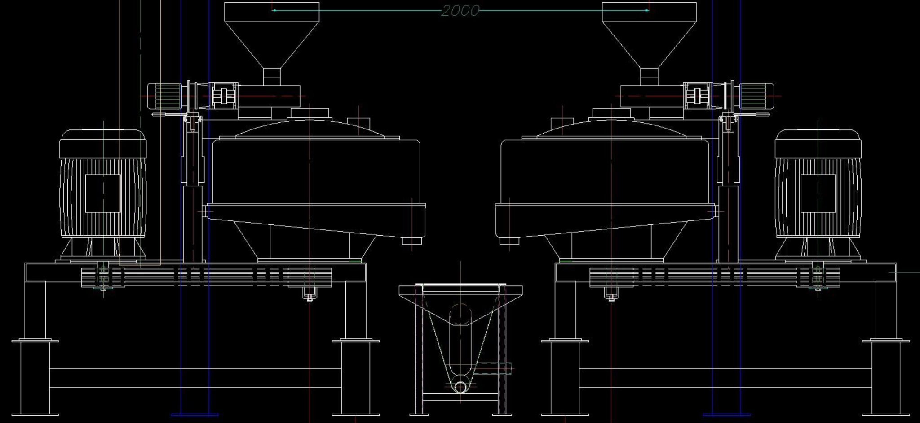
Semi Muhle Mill, Cocoa Grinding Process
05
Once the beans are roasted, they are cooled and then ground into cocoa nibs. The nibs are then ground into a fine cocoa paste called chocolate liquor or cocoa liquor. The grinding process can take several hours and involves specialized equipment such as blade grinders, beater blade mills, and conical stones.

Slide 8
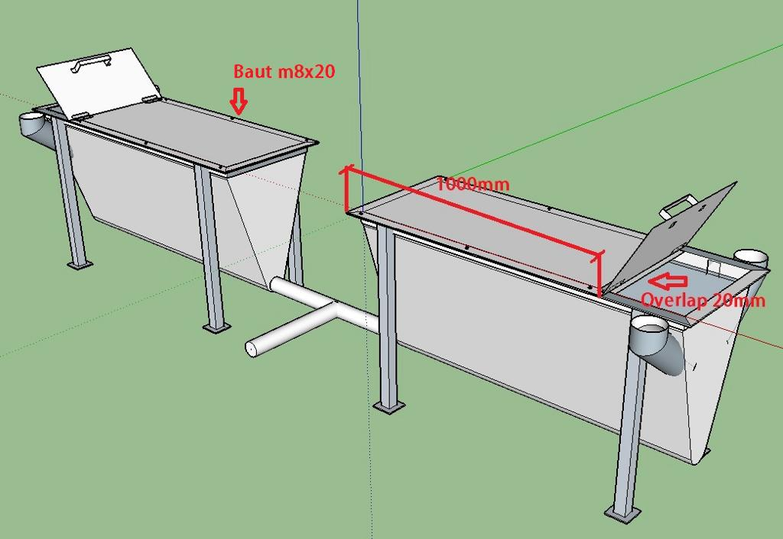
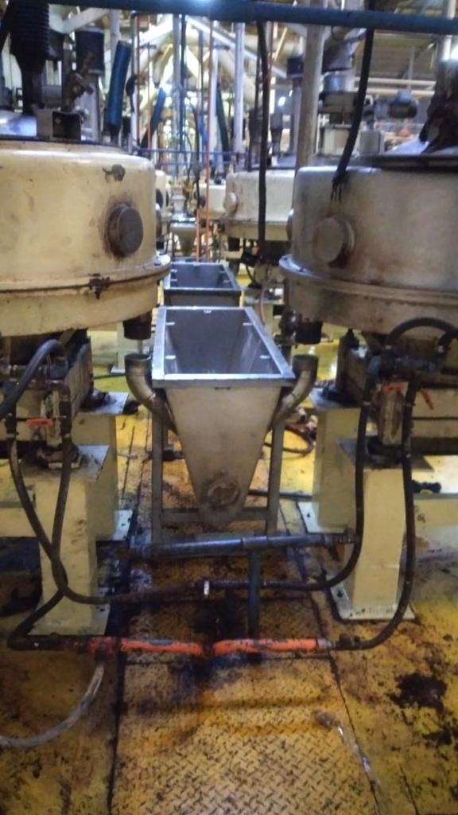
Tank Collecting
06
Used to hold the Cocoa Liquor (product), before it is transferred by pump to the homogenizer tank.

Slide 9
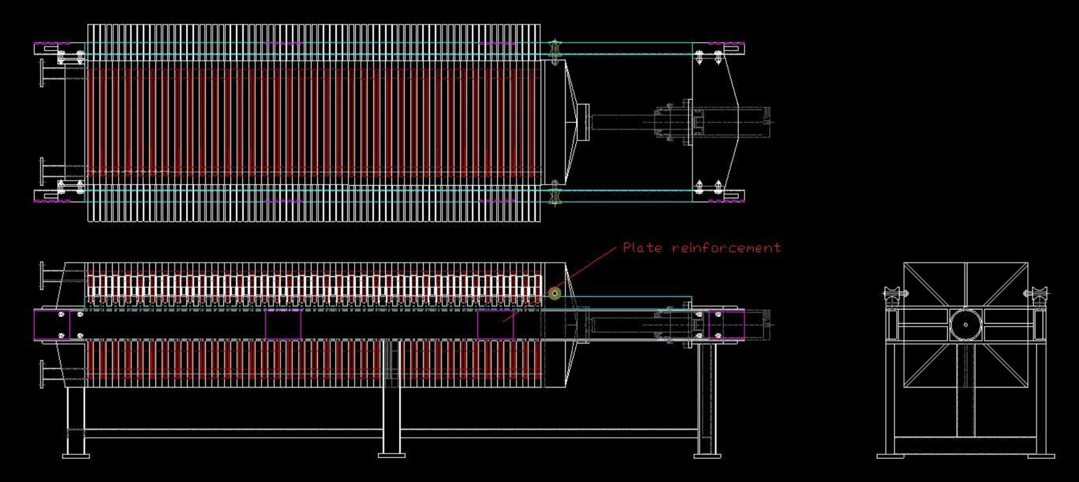
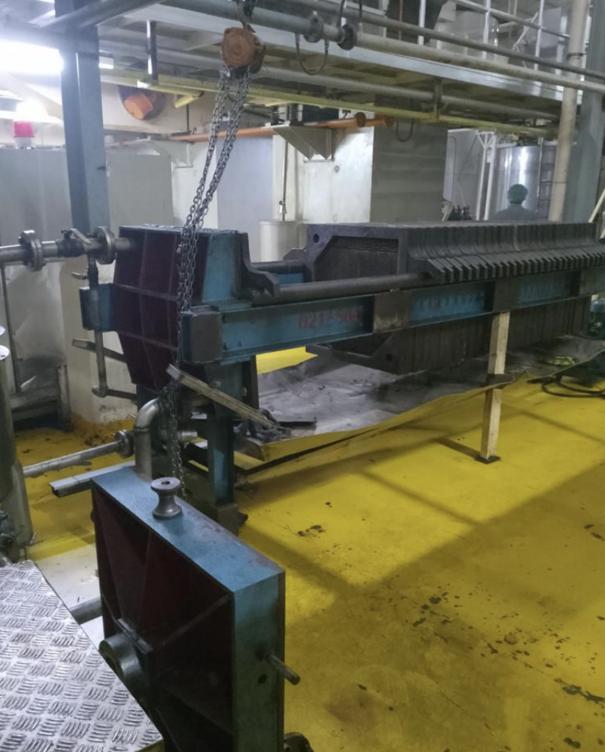
Cocoa Butter Filtration Machine
07
The filtering is made through a fabric having well defined flows and permeability characteristics. The product to be filtered, pushed by the feeding pump into the filtering elements (0-500 bar), has to flow, in its liquid state, through the fabric, giving so the solid particles which will be held by the cloths.
Used to hold the Cocoa Liquor (product), before it is transferred by pump to the homogenizer tank.

Slide 10
Kasman Andries Sitio
sitio.kasmandries@gmail.com
https://www.linkedin.com/in/kasmandriesitio/

